Slide 1
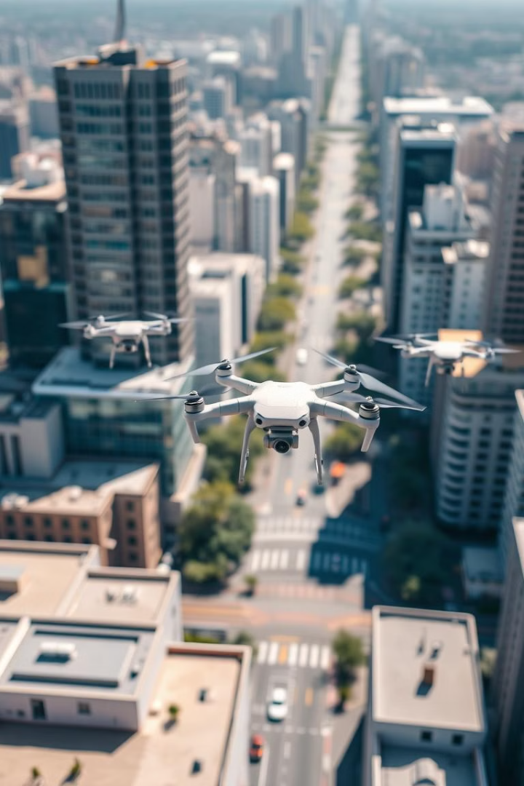
Path Planning for AI Drone Delivery Systems
Welcome to this presentation on path planning for AI drone delivery systems. We will explore the innovative technologies and the transformative potential of this rapidly growing field.
Team Name : Warriors
Team Members : A.Srimukhi
P.Saikranthi Kumar
V.Shashikanth
AI HACK DAY 2025
Date : 25th January 2025

Slide 2
Introduction to AI-powered drone delivery
Revolutionizing Logistics
Expanding Reach
AI drone delivery is revolutionizing the logistics industry, offering faster and more efficient delivery solutions. This technology holds immense potential for streamlining operations and reducing delivery times.
It also expands access to remote areas and underserved communities, bridging geographical gaps and promoting inclusivity in the delivery process.

Slide 3
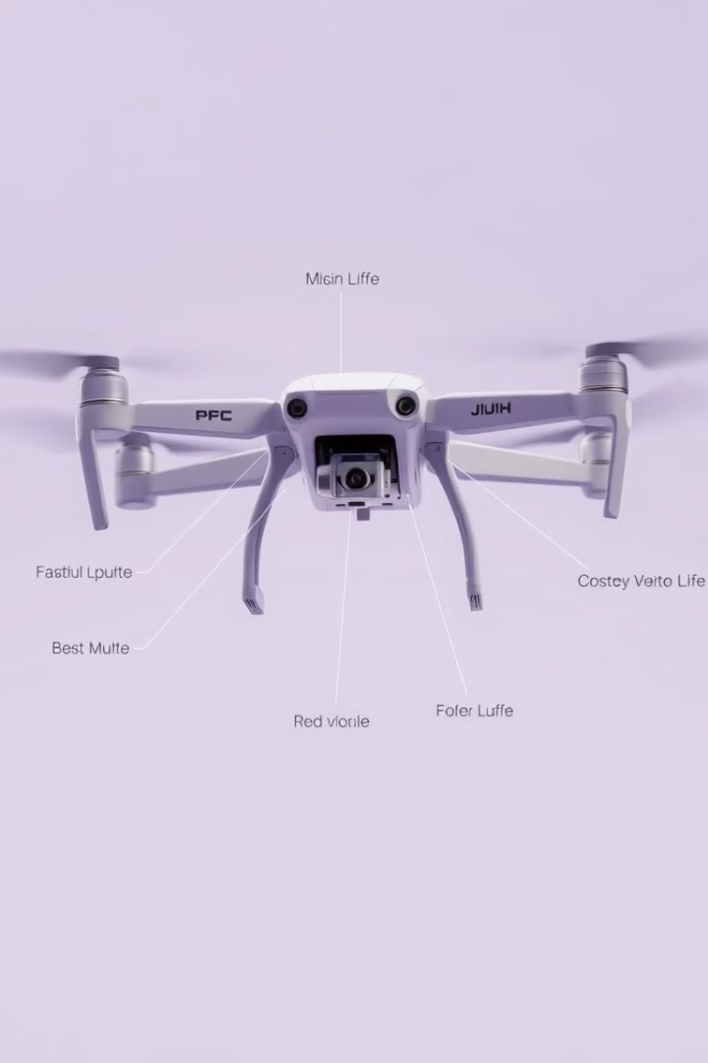
Innovations in drone autonomy and navigation
1
Advanced Sensors
2
Autonomous Navigation
Modern drones are equipped with sophisticated sensors, including cameras, lidar, and radar, allowing for accurate perception of their surroundings.
AI algorithms enable autonomous navigation, allowing drones to plan optimal flight paths and avoid obstacles in real-time.
3
Dynamic Route Optimization
AI optimizes routes dynamically based on real-time traffic conditions, weather patterns, and other factors, ensuring efficient delivery.

Slide 4
Technical implementation overview: sensors, algorithms, and infrastructure
Sensor Fusion
Path Planning Algorithms
Ground Infrastructure
Sensors like cameras, lidar, and radar provide comprehensive data. AI algorithms fuse this data to create a detailed map of the environment.
AI algorithms determine optimal flight paths, considering factors like distance, obstacles, and weather conditions, minimizing delivery time.
Integration with existing infrastructure like traffic control systems and communication networks is crucial for safe and efficient drone operations.

Slide 5
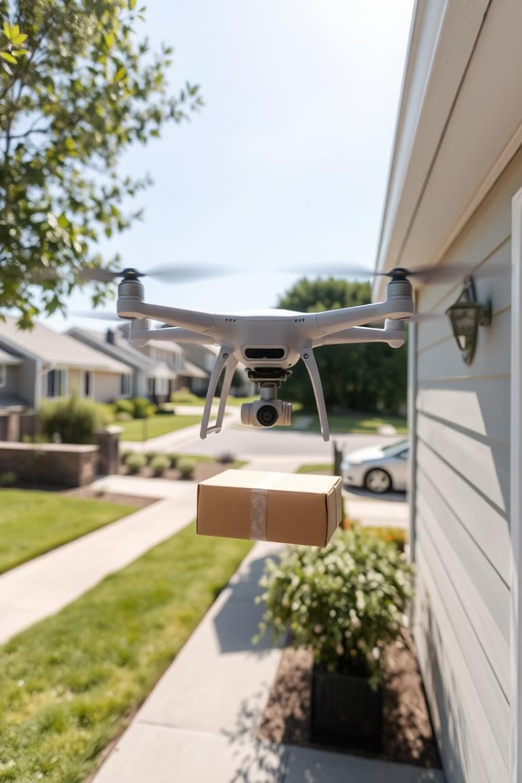
Real-world applications and use cases
Package Delivery
Emergency Response
Delivering small packages, like groceries or pharmaceuticals, to residential and commercial areas.
Delivering medical supplies, blood samples, or emergency equipment to remote locations during critical situations.
Infrastructure Inspection
Inspecting power lines, bridges, or pipelines for damage or maintenance needs.

Slide 6
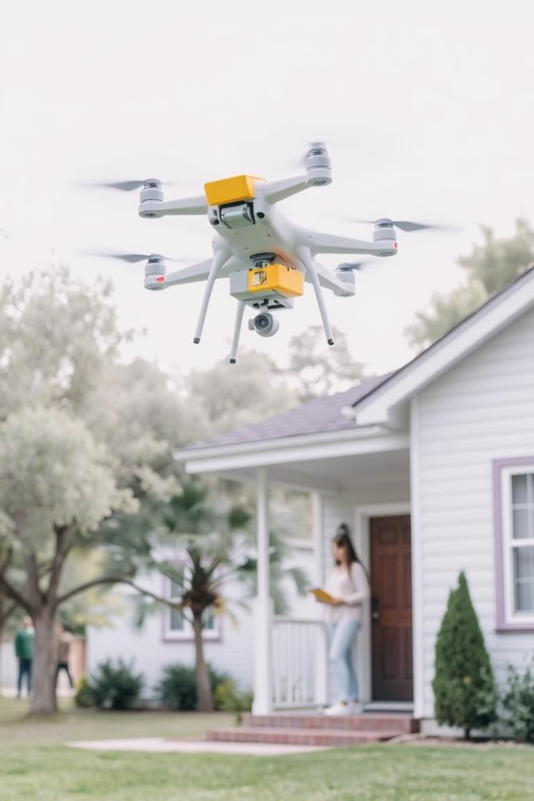
Demonstration of a drone delivery project
1
Package Pickup
The drone picks up a package from a designated pickup station.
2
Flight Path Planning
AI algorithms plan the optimal flight path, taking into account obstacles and traffic.
3
Navigation and Delivery
The drone autonomously navigates and delivers the package to the recipient.

Slide 7
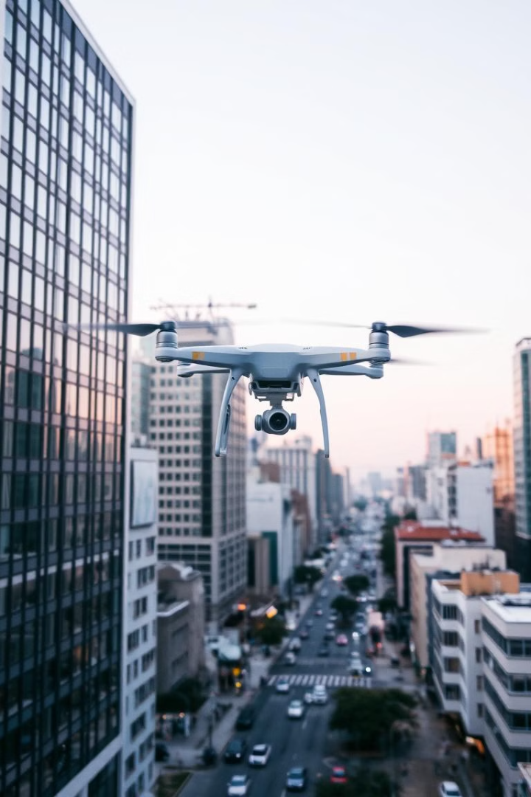




Challenges and limitations of current systems
Regulations and Safety
Navigating complex regulations and ensuring public safety during flight operations.
Weather Conditions
Dealing with adverse weather conditions like rain, wind, and fog, which can impact drone flight.
Data Security and Privacy
Protecting sensitive data collected by drones and ensuring user privacy.
Range and Payload Limitations
Improving drone range and payload capacity to accommodate larger and heavier packages.

Slide 8




Future work and potential improvements
1
Improved AI
2
Advanced Sensors
3
Integration with Smart Cities
4
Hybrid Delivery Systems
Further research in AI, advanced sensors, and integration with smart city infrastructure will enable more efficient and resilient drone delivery systems.

Slide 9
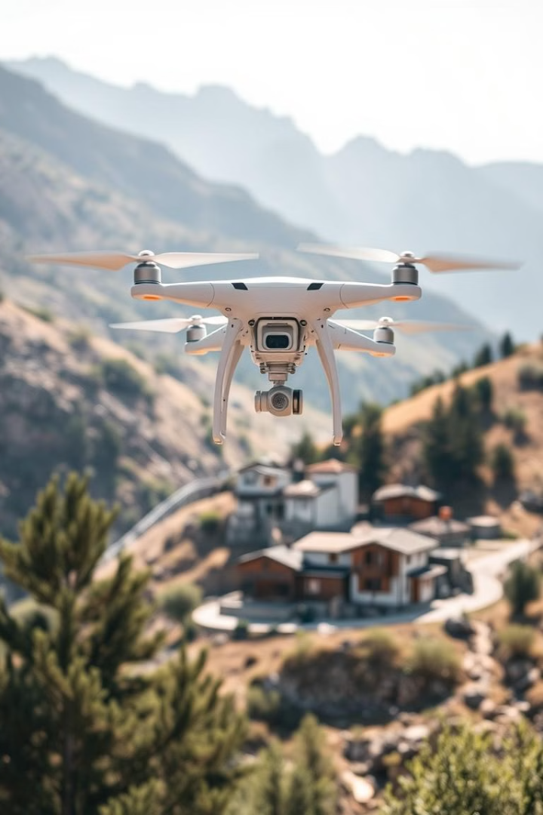
The societal impact of autonomous drone delivery
100M+
20%
Jobs
Emissions
Potentially creating millions of new jobs in drone maintenance, logistics, and related fields.
Reducing carbon emissions by replacing traditional delivery vehicles with electric drones.
$100B
Market
Expected to generate a massive economic impact through new business opportunities and increased efficiency.

Slide 10

Conclusion: the role of AI in the future of logistics
AI-powered drone delivery systems are revolutionizing the logistics industry, offering numerous benefits in terms of efficiency, accessibility, and sustainability. As technology continues to evolve, we can expect even more innovative and transformative applications of AI in the future of logistics.

Slide 11
Thank you

